Slide 1

Modern way to recruit donors 4/17/2016, Pirate Summit Kyiv

Slide 2
Every 2sec someone needs blood
90% of people eligible to donate blood are not doing so
Almost 80% agree to donate if they be asked
http://www.redcrossblood.org/learn-about-blood/blood-facts-and-statistics
http://www.euro.who.int/en/health-topics/Health-systems/blood-safety/data-and-statistics

Slide 3
Problems
The absence of a single coordination center for donation centers, recipients and donors
Lack of first-time donors almost all over the world
A complex and inefficient process of recruitment donors according to strong requirements and restrictions
Huge amount of blood utilization

Slide 4
Solution
Knowledge & donors recruitment system based on social media monitoring, AI bots and messengers

Slide 5


Product
Social networks monitoring
Bot platform
Web (knowledge) system

Slide 6
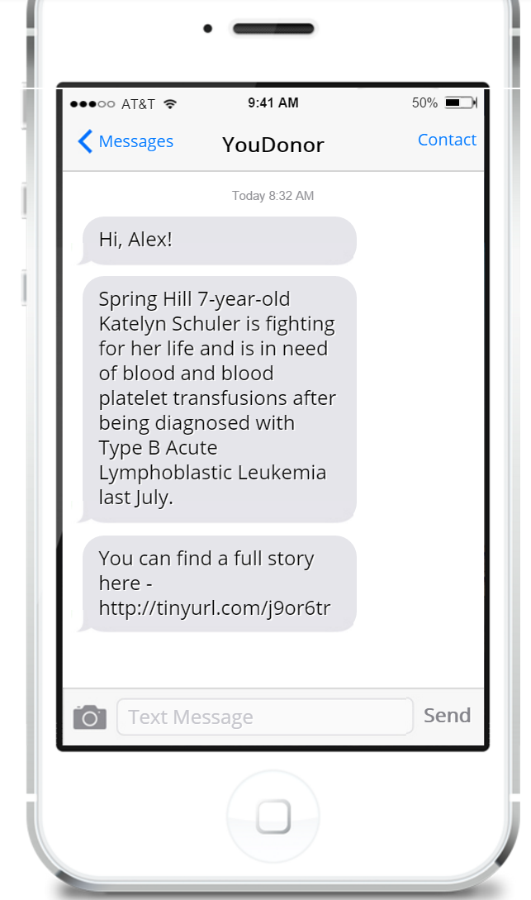
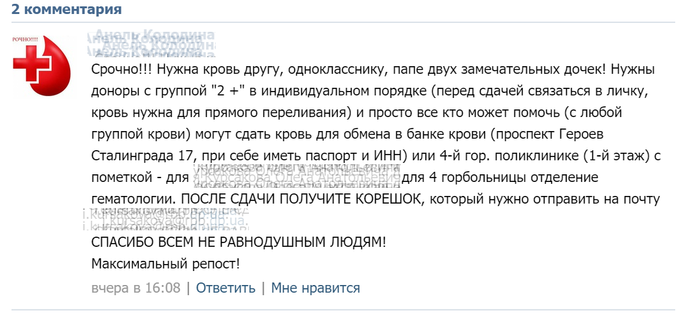
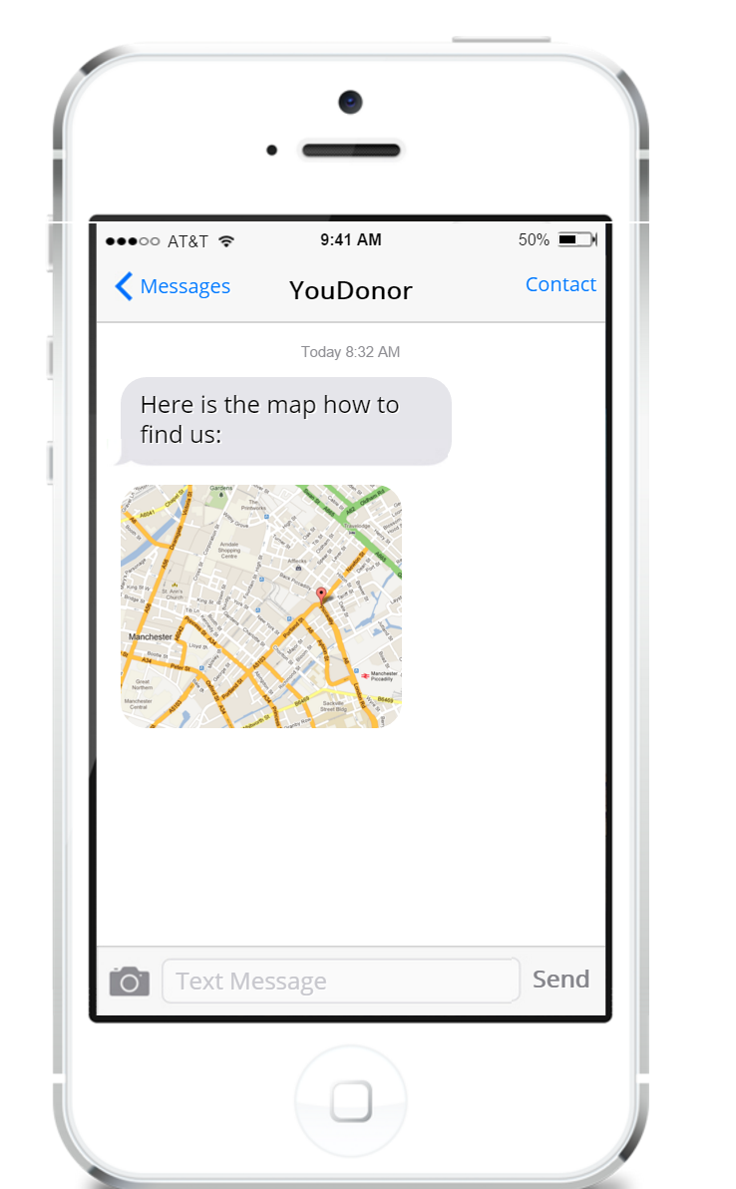
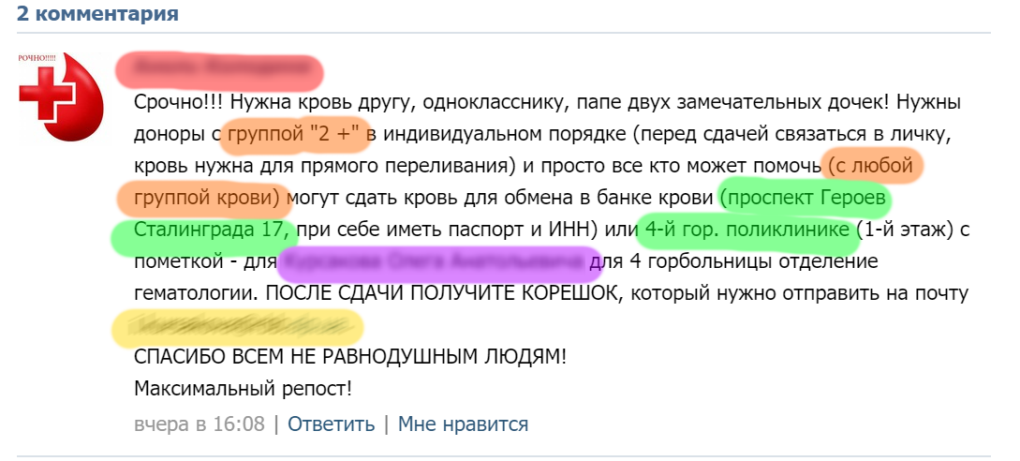
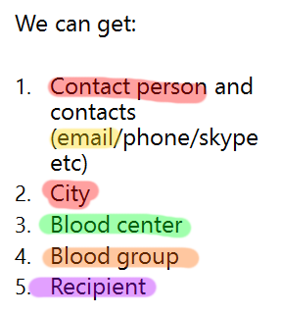
How it works

Slide 7
Traction
4500+ registered blood donors
100+ recipients
20 minutes takes to find blood donor for selected cities in Ukraine
480% weekly total reach in Facebook
1000 users per day on website
3,5 minutes average session duration
3,82 pages per session

Slide 8
Business Model
Direct sales to NGOs, Red Cross, government health institutions for conducting special campaigns or using our system on top of existing ones.
It can be subscription model (pay monthly and use) or recruitment-based ($N/recruitment, recruit as many donors as you need).
Personal or center based subscription

Slide 9
Industry Statistics & Market Size
36,000
Units of red blood cells are needed every day in the U.S.
$24bn
Annual revenue
2.8%
Annual growth
Blood & Organ Banks Market Research Report | NAICS 62199 | Oct 2015
http://www.ibisworld.com/industry/default.aspx?indid=1582

Slide 10
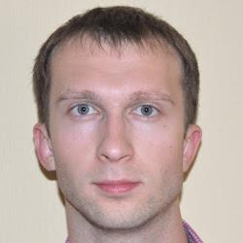
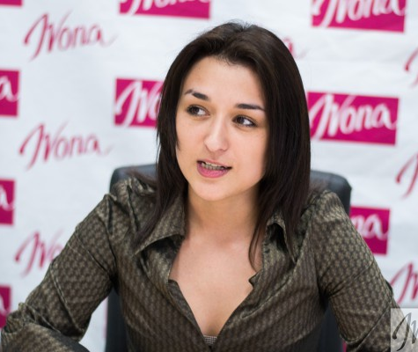
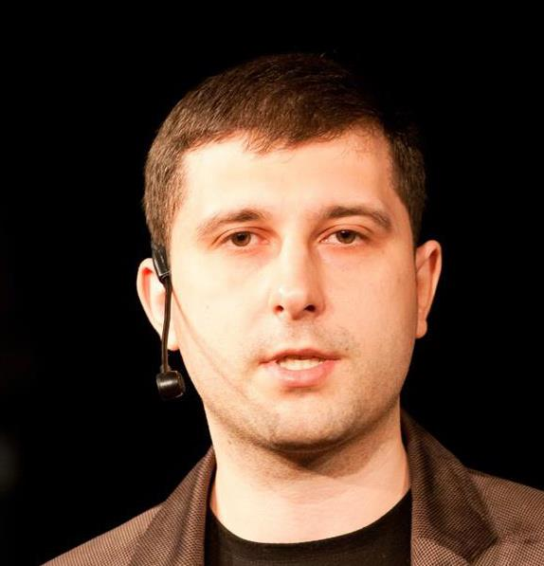
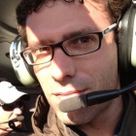
Team
Iryna Slavinska
CEO, co-founder
President at All-Ukrainian youth NGO “Association of young blood donors of Ukraine”
Oleksandr Krakovetskyi
CTO, co-founder
CEO DevRain Solutions.
Microsoft Regional Director
PhD in Computer Science
Mihail Galushko
Co-founder
CTO DevRain Solutions
Microsoft Most Valuable Professional
Diego de Jódar Advisor
Passionate problem solver with +15 Years of experience working at the intersection of Marketing & Product

Slide 11
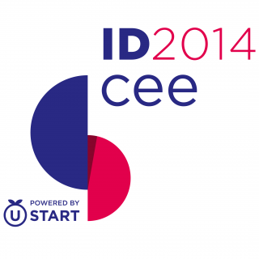






Awards and visibility
The winner of hackhaton SocialBoost at IDCEE conference 2014.
The best technological solution in social projects sphere
and NGOs within the contest from GURT (www.gurt.org.ua)
and Microsoft Ukraine
The winner of Stockholm Startup Weekend: Social Innovation 2016
More than 100 references in the media and TV

Slide 12
Contacts
info@donor.ua
alex.krakovetskiy@donor.ua
i.slavinska@donor.ua
+38 (063) 26 55 367
Skype: alex.krakovetskiy
https://www.f6s.com/udonors/
https://www.facebook.com/udonors/
http://angel.co/udonors

